Slide 1

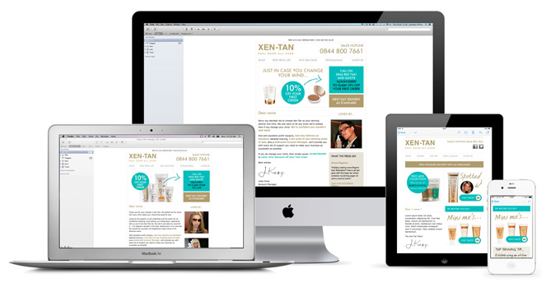
Responsive Emailer

Slide 2
Topics Covered
About Responsive Email?
Responsive Email Guidelines
How to Build a Responsive Email?
Things to Remember while Developing Responsive Emailer
Simple Emailer and Complex Emailer
Responsive Email Template
Text (.txt) Emailer
Responsive Email Checklist
Responsive Email Assumptions Doc.
Responsive Emailer View in Litmus
Questions & Feedback

Slide 3

About Responsive Email?

Slide 4
About Responsive Email
Responsive Design is a current trend which aims to react to user’s actions and detect the device which the site is currently being viewed on, in order to provide the best user experience possible in terms of navigability and readability. In short - depending on what type of device (and resolution) the user views the initial website on, means what type of experience they receive.
Responsive design allows us to re-format the content of the email when it is opened on a smaller screen.
With the variety of email clients in the market, support of various techniques is a challenge on mobile devices .
iPhone, iPad and Android devices all use the WebKit rendering engine therefore it supports for @media queries.
There are some exceptions between the two however; one comes in the shape of Gmail's own app that you can download on both iPhone and Android. Since the Gmail Web Client doesn't support embedded CSS (and @media queries is a variant of that), it's no surprise that media queries are not supported in any of the Gmail mobile apps either.

Slide 5
About Responsive Email
The other exception we’ve found during testing is mixing the default Android email client, and email addresses which use a Microsoft Exchange Server to deliver those emails (usually Exchange 20 10). For some unknown reason, the required code to enable a responsive design is stripped out by the server and users are faced with the standard email instead.
Blackberry are slowly but surely moving towards using the WebKit rendering engine, but aren't quite there just yet, therefore support should improve as newer devices appear on the market. As it stands, only operating system 4.7.1 and greater have partial support for @media queries.
Windows 7 handsets are different in the fact that the browser's base functionality is built upon a hybrid of Internet Explorer 6 & 7, which do not support @media queries at all . This means that users of Windows 7 handsets will have to cope with the basic email.
The most important plus point is that responsive design provides a massively better user experience for the end user.

Slide 6
About Responsive Email
We can:
Resize images
Reflow copy
Hide content on mobile and Desktop
Stack columns into rows
Make buttons/links larger
Background Image
We can’t (reliably):
Custom Fonts
Java Script
HTML5 Syntax
External files
Gradient CSS

Slide 7

Responsive Email Guidelines

Slide 8
Responsive Email Guidelines
Designing for mobile isn’t simply a matter of taking a crack at writing mobile-specific CSS. Other things to consider are:
Use tables for layout: Because clients like Gmail and Outlook 2007 have poor support for float, margin and padding, you’ll need to use tables as the framework of your email.
Set the width in each cell, not the table: When you combine table widths, td widths, td padding and CSS padding into an email, the final result is different in almost every email client. The most reliable way to set the width of your table is to set a width for each cell, not for the table itself. Also avoid using percentage based widths. Clients like Outlook 2007 don’t respect them, especially for nested tables.
Use a container table for body background colors: Many email clients ignore background colors specified in your CSS or the <body> tag. To work around this, wrap your entire email with a 100% width table and give that a background color.
Avoid unnecessary whitespace in table cells : Where possible, avoid whitespace between your <td> tags. Some email clients (ahem, Yahoo! and Outlook.com) can add additional padding above or below the cell contents in some scenarios, breaking your design for no apparent reason.
Always move your CSS inline : Gmail is the culprit for this one. By stripping the CSS from the <head> and <body> of any email, we’re left with no choice but to move all CSS inline.
Avoid shorthand for fonts and hex notation: A number of email clients reject CSS shorthand for the font property. For example, never set your font styles like this.
p { font:bold 1em/1.2em georgia,times,serif; }

Slide 9
Responsive Email Guidelines
Instead, declare the properties individually like this.
p {
font-weight: bold;
font-size: 1em;
line-height: 1.2em;
font-family: georgia,times,serif;
}
Links : Some email clients will overwrite your link colors with their defaults, and you can avoid this by taking two steps. First, set a default color for each link inline like so:
<a href="http://somesite.com/" style="color:#ff00ff">this is a link</a>
Next, add a redundant span inside the a tag.
<a href="http://somesite.com/" style="color:#ff00ff">
<span style="color:#ff00ff">this is a link</span>
</a>
Always include the dimensions of your image : If you forget to set the dimensions for each image, a number of clients will invent their own sizes when images are blocked and break your layout. Also, ensure that any images are correctly sized before adding them to your email. Some email clients will ignore the dimensions specified in code and rely on the true dimensions of your image.

Slide 10
Responsive Email Guidelines
Don’t forget alt text
Use the display hack for Outlook.com: For some inexplicable reason, Outlook.com adds a few pixels of additional padding below images. A workaround is to set the display property like so.
img {display:block;}
This removes the padding in Outlook.com and still gives you the predicable result in other email clients.
When possible, use display: none; to hide extraneous details in your mobile layout. Elements like social sharing buttons may be great in the desktop inbox, but aren’t always easy to use by the recipient on mobile devices.
Validate your email with W3C Validator

Slide 11

How to Build a Responsive Email?

Slide 12
Build a Responsive Emailer
Building a responsive template /email for mobile devices requires the use of CSS3 media queries
(a variation of Embedded CSS which we normally recommend avoiding ).
For example:
@media only screen and (max - device - width: 480px)
{
table[class="hide"]
{
display: none !important;
}
img[id="logo"]
{
width: 50 px !important; height: 25 px !important;
}
}
Breaking the above down, all the code is saying that when a device with a maximum resolution of 480 pixels or below views this page ( for example an iPhone ) , then apply the following styles.

Slide 13
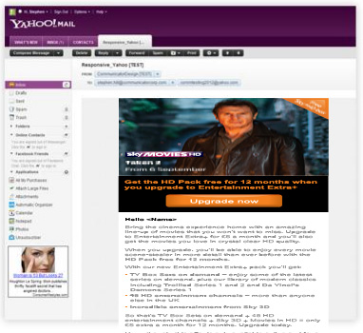
Build a Responsive Emailer
One thing you may have noticed which is different from your standard Embedded CSS, is the introduction of square brackets around class names. These are called ‘Attribute Selectors’ and the main point of these are to fix a well - known problem in Yahoo! Mail.
For some unknown reason, Yahoo! Mail gives precedence to the @media query, which means that even if you view the email on a PC, you will still be faced with the mobile version of the email. Using the ‘Attribute Selectors’ ensures the correct version is not only served up to Yahoo! Mail recipients but it leaves emails viewed in other email clients untouched.

Slide 14
Build a Responsive Emailer
Building a single column template
Single column templates are by far the easier option when it comes to designing a responsive template i.e. they’re easier to code, and if things don’t render as you’d expect , they degrade much more gracefully. Using the above media query as a guide we can do the following:
@media only screen and (max - device - width: 480px)
{
table[class= table - shrink ]
{
width: 325px !important;
}
}
Then, we can then ‘reference’ that class on the relevant table:
< table border=“0" align="center" cellspacing="0" cellpadding="0" class="table - shrink " >
<tr>
<td width="650“ bgcolor="#FFFFFF" valign="top">dummy text</td>
</tr>
</table>

Slide 15
Build a Responsive Emailer
Building a two column template
Building a two column template, although slightly harder, can still be done without having to resort to adding too much code to the main @media query or the template itself . In theory, the idea is that the second column will wrap underneath the first column when viewed on a mobile device :
To achieve the desired result when building a website, CSS properties such as float: left ; would naturally be used but as we’re building an email older HTML attributes such as align=”left ” are an adequate replacement.
In the following example we will take a 650 pixel wide table with one table cell, and inside that table cell we insert 2 nested tables; one with the width of 325 pixels which is aligned left, and another similar table which is also 325 pixels wide but this time with no align property.
The outcome when viewed on mobile will cause the table with no align property to wrap underneath its partner. The code to achieve this looks as follows; first@media query:
@media only screen and (max - device - width: 480px)
{
table[class= table - shrink ]
{
width: 325px !important;
}
}

Slide 16
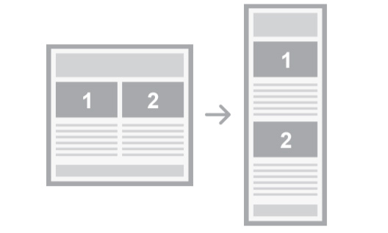
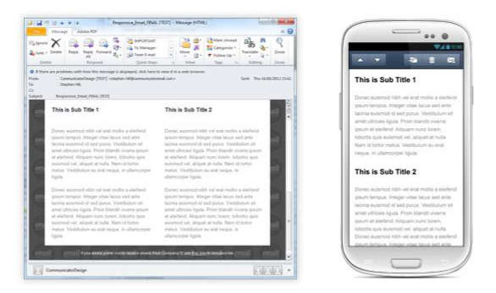
Build a Responsive Emailer
2 column template
Example:

Slide 17
Build a Responsive Emailer
Second, the HTML it self:
<table border="0" cellpadding="0" cellspacing="0" align="center“ class="table-shrink">
<tr><td width="325" bgcolor="#FFFFFF">
<table width="325" border="0" cellspacing="0" cellpadding="0“ align="left">
<tr>
<td valign="top">dummy text</td>
</tr>
</table>
</td></tr>
<table width="325" border="0" cellspacing="0" cellpadding="0">
<tr>
<td valign="top">dummy text</td>
</tr>
</table>
</td>
</tr>
</table>

Slide 18
Build a Responsive Emailer
Building a fluid template
Unlike the two examples above which are fixed at 325px wide, it is also possible to create a fluid template . The fluid template, which no matter what resolution device a user views the email on , shrinks and stretches accordingly. To do this, instead of using specified widths, we instead use percentages e.g.
@media only screen and (max - device - width: 480px)
{
table[class= table - shrink ]
{
width: 100% !important;
}
}
This slightly amended @media query will mean that when a device with a maximum resolution of 480 pixels or below views this email , no matter what resolution the device has, the table will change to 100%.
For single column templates this is a relatively small change; however for two columns it becomes slightly harder and requires some small amends to the template’s HTML:

Slide 19
Build a Responsive Emailer
<table width="650" border="0" cellpadding="0" cellspacing="0" align="center“ class="table-shrink">
<tr>
<td bgcolor="#FFFFFF">
<table width=“50%" border="0" cellspacing="0" cellpadding="0“ align="left">
<tr>
<td valign="top">dummy text</td>
</tr>
</table>
</td></tr>
<table width=“50%" border="0" cellspacing="0" cellpadding="0">
<tr>
<td valign="top">dummy text</td>
</tr>
</table>
</td>
</tr>
</table>

Slide 20
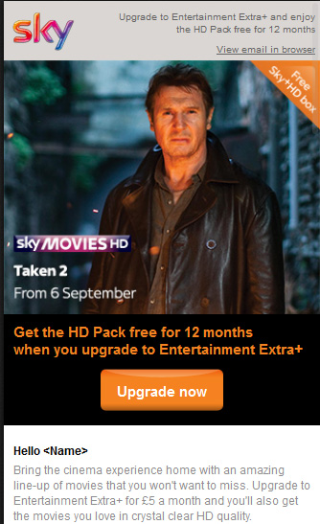
Build a Responsive Emailer
Mobile Version

Slide 21
Build a Responsive Emailer
As you can tell from the above HTML, we have amended the two side - by - side tables to percentages (50%) rather than fixed widths . Very little changes when viewed on either desktop or webmail client, but by changing it to a percentage means a fluid layout on mobile devices .
Creating fluid images in a responsive email
Mobile devices can come in all shapes and sizes so it’s important that no matter what resolution mobile the user has, that images and text make use of the screen size as much as possible. One solution is to create fluid images; which similar to a fluid template, shrink and stretch depending on device.
To do so, an added @media query can be used in the main template which then can be ‘referenced’ when building the email. The added @media query looks like so:
@media only screen and (max - device - width: 480px)
{
img [ class=responsive - image ]
{
width: 100% !important; max - width: 100% !important; height: auto !important;
}
}

Slide 22
Build a Responsive Emailer
Hiding / Showing content
Although very much a contentious issue amongst Web / Email Designers, some may find it necessary to pick and choose which content to display to recipients when viewing the email on mobile devices. The argument is that most mobile users do everything desktop users will do so all content should remain the same only presented in a usable way.
however should you choose to remove certain content on mobile devices e.g. limiting the amount of stories; this is how you do it:
@media only screen and (max - device - width: 480px)
{
td [class= table - cell - hide ]
{
display : none !important;
}
}
The above @media query is saying when a device with a maximum resolution of 480 pixels or below views this page , then set the content (in this case a table cell) not to display .

Slide 23

Things to Remember While Developing Responsive Emailer

Slide 24
Things to Remember…
Always use inline css for desktop version.
For mobile version use media query and classes.
Always use “font-weight:bold “ css property to make the text bold. Avoid using <strong> tag because yahoo is not supporting that.
Always use same size of cta buttons etc. for both mobile and desktop versions.
Always use html entity for special characters like (&amp;, &ndash;) etc.
To color the text always use hash code format e.g. color:#ff0000; don’t use rgb format, rediff.com is not supporting that format.
Avoid using <br /> tag to maintain the spacing.
Always make a text emailer (.txt) with every HTML emailer. It is mandatory for sky responsive email.
Always fill Responsive Email Checklist
Always write assumptions (if any) in a doc. File
Responsiveness will work only for configured apps, if you open responsive emailer in mobile browser, it will render desktop version.
To fix underline issue in iphone, use below given solution:
.appleLinks a {color:#FFFFFF !important; text-decoration: none;}
.appleLinksWhite a {color:#ffffff !important; text-decoration: none;}

Slide 25
Things to Remember…
span[class="applelinks"] {font-size:12px !important;text-transform:uppercase;}
<span class="appleLinks">Call 08442 411 362</span>
The CTA switch solution between desktop and mobile version given below:
This will hide the text (Call 08442 411 362) in desktop version and show the text(Live Chat ) in desktop version:
<span class="emailnomob" style="font-weight:bold;font-family:Arial, Helvetica, sans-serif; font- size:11px; line-height:12px; color:#ffffff; text-decoration:none; "><a href="https://skyid.sky.com/signin/mysky?successUrl=https%3A%2F%2Fmy.sky.com%2Fmysky &cancelUrl=http%3A%2F%2Fwww.sky.com%2Fmysky%2Findexb.html" style="color:#ffffff;text- decoration:none">Live Chat</a></span>
<span class="showText" style="color:#4369b2; display:none; font-size:0; max-height:0; line- height:0;"><span class="appleLinks">Call 08442 411 362</span></span>
This will show the text(Call 08442 411 362) in mobile version and class=“emailnomob” hide the text
{Live Chat} in mobile version:
span[class=showText]{ font-weight:bold !important;font-family:Arial, Helvetica, sans-serif important; font-size:11px !important; line-height:12px !important; color:#ffffff !important; text- decoration:none !important; display:block !important;max-height:none !important;
}

Slide 26
Simple Emailer and Complex E-mailer

Slide 27
Simple Emailer
Image
Text
Button
Same Content flow in mobile
Same Content for mobile
Arial Font

Slide 28
Complex Emailer
Image
Text
Button
Gradient Buttons as Image / Background Button
Same/Different Content flow in mobile
Same/Different Content for mobile
Arial Font
Hide Content in Desktop

Slide 29
Responsive Email Template

Slide 30
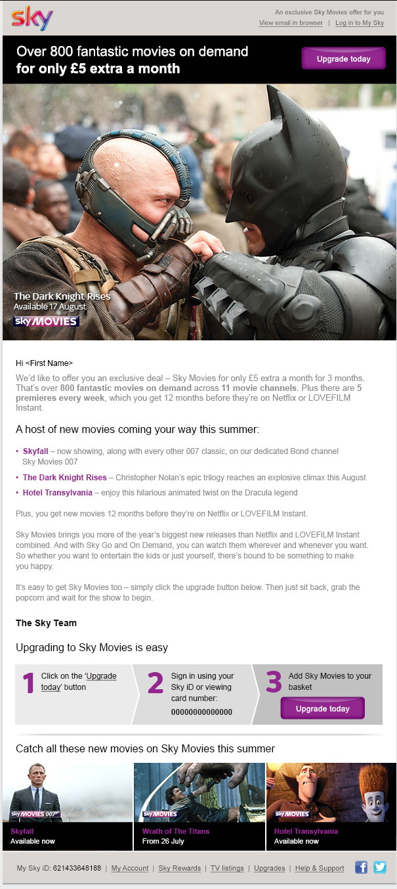
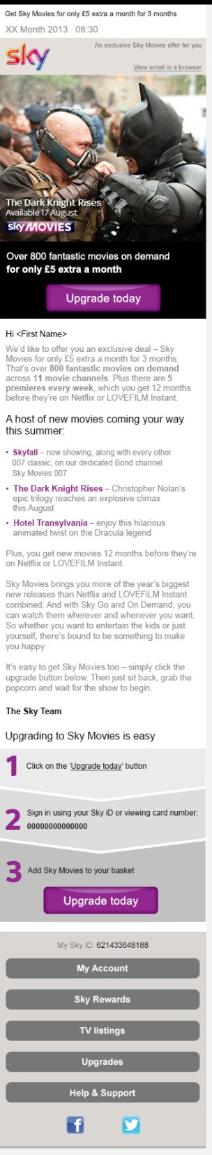
Responsive Email Template
Desktop Version
Mobile Version

Slide 31
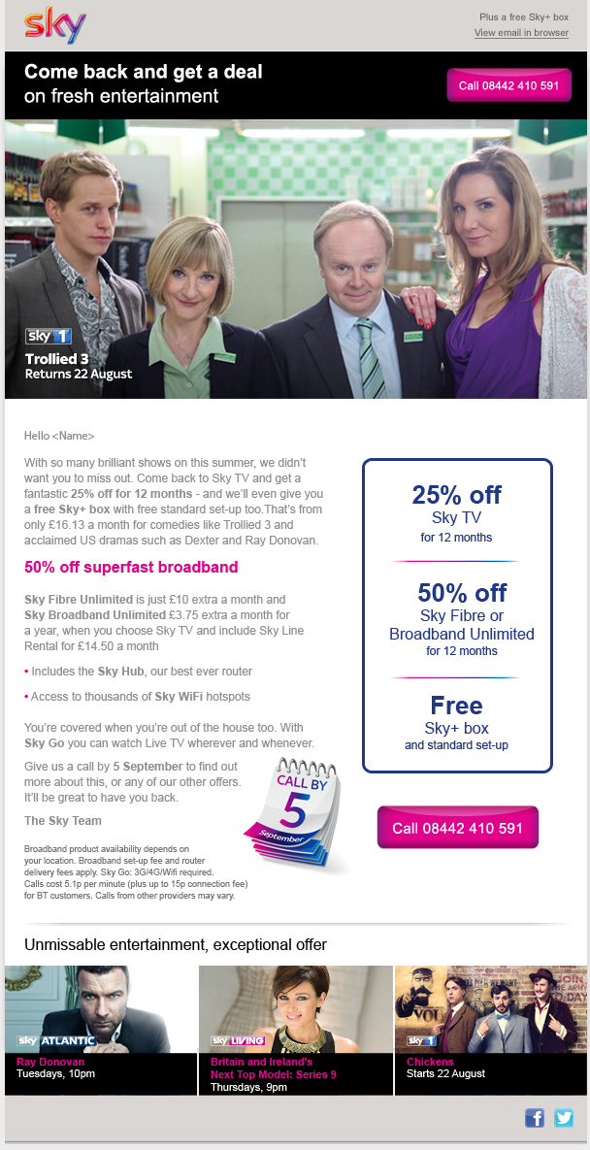
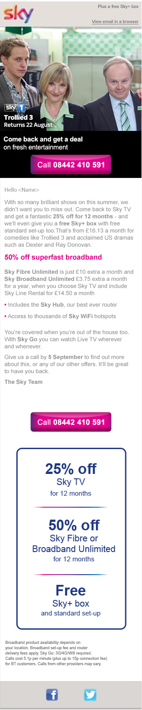
Responsive Email Template
Desktop Version
Mobile Version

Slide 32
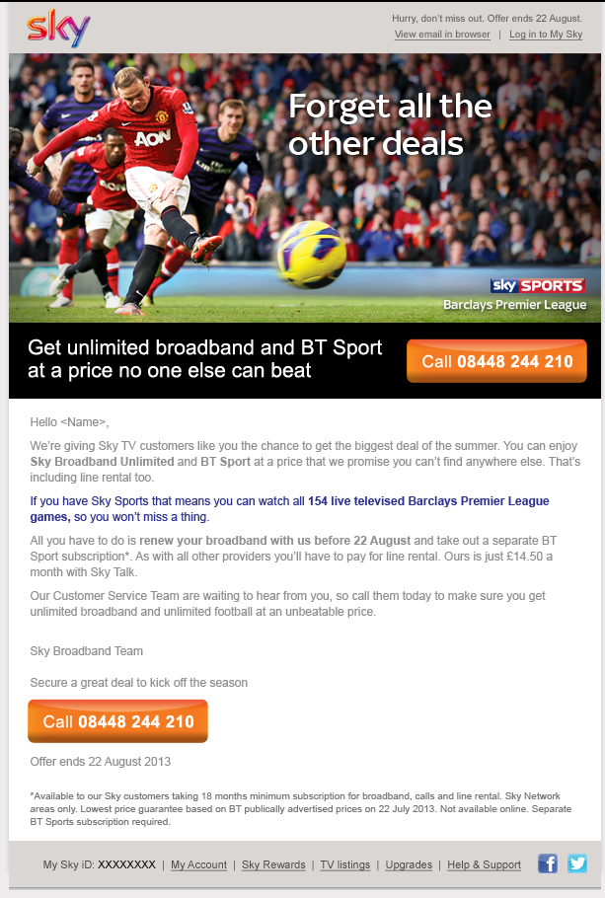
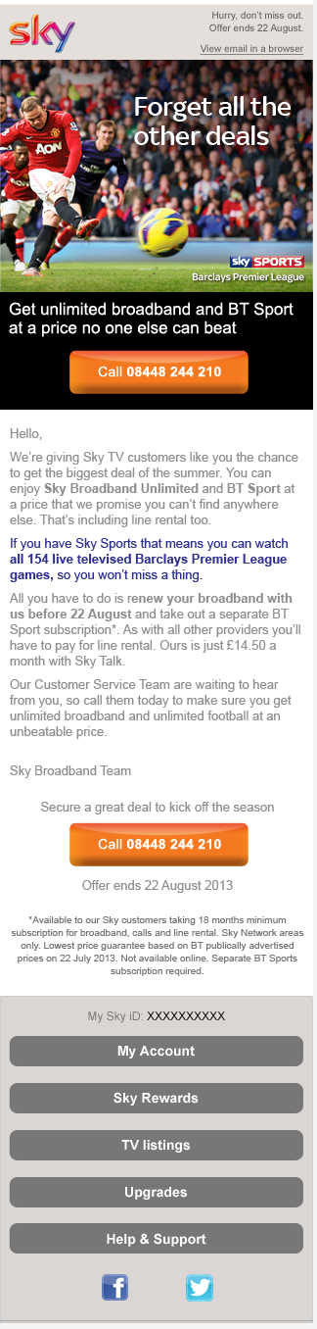
Responsive Email Template
Desktop Version
Mobile Version

Slide 33
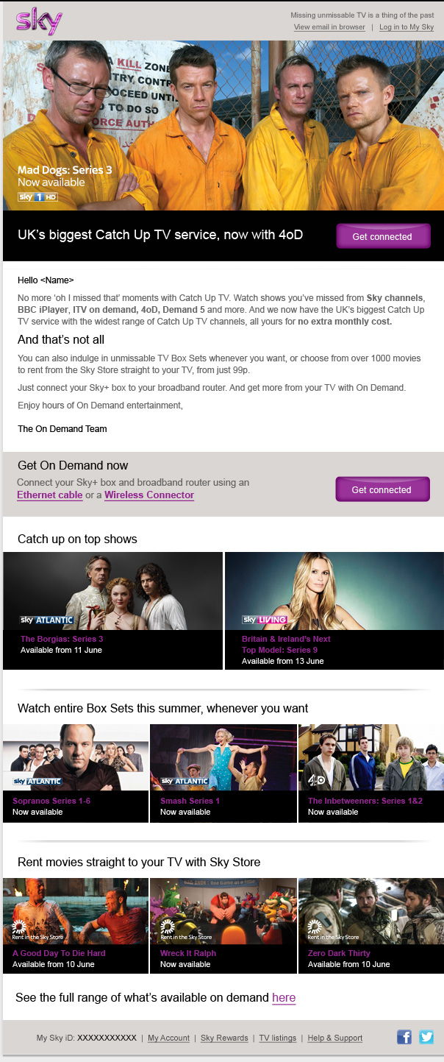
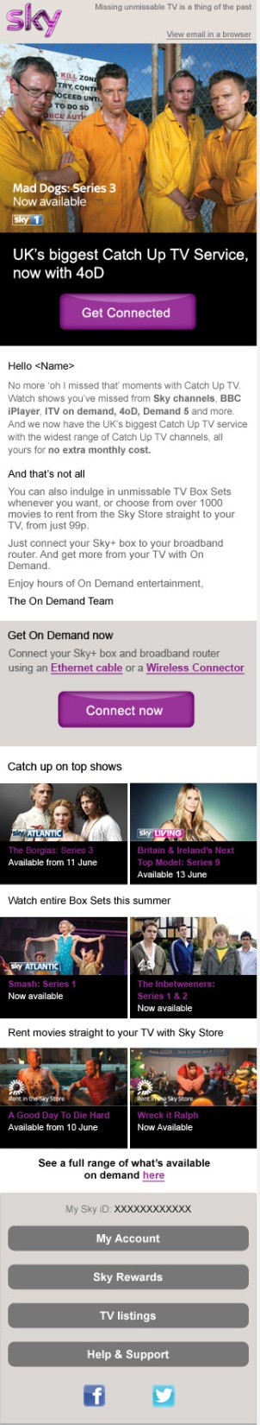
Responsive Email Template
Desktop Version
Mobile Version

Slide 34
Text (.txt) Emailer

Slide 35
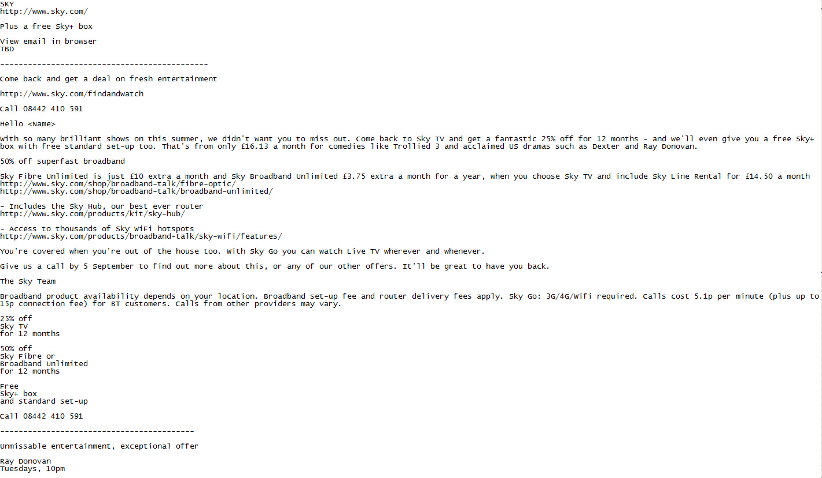
Text (.txt) Emailer
For sky emailer, We always make a text (.txt) emailer for a particular html emailer. That will contain only text including urls with tracking code. It is mandatory for all developers to make a text (.txt) emailer before sending that to QA.

Slide 36

Responsive Email Checklist

Slide 37
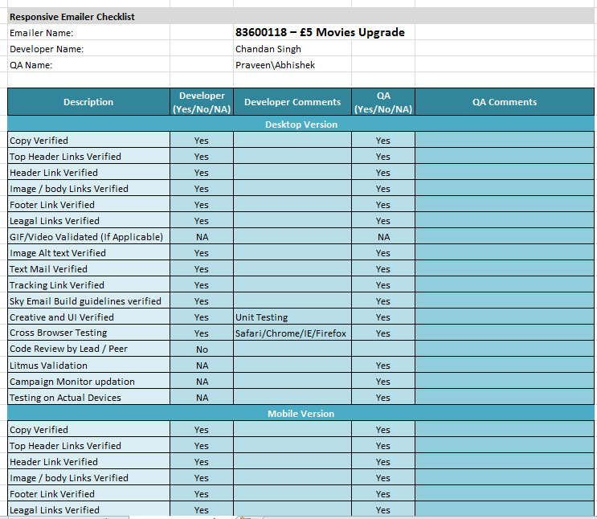
Responsive Email Checklist
We are maintaining a checklist for all responsive as well as non responsive emailer. It is mandatory for all developers to fill this checklist before sending that to QA.

Slide 38

Responsive Email Assumptions Doc.

Slide 39
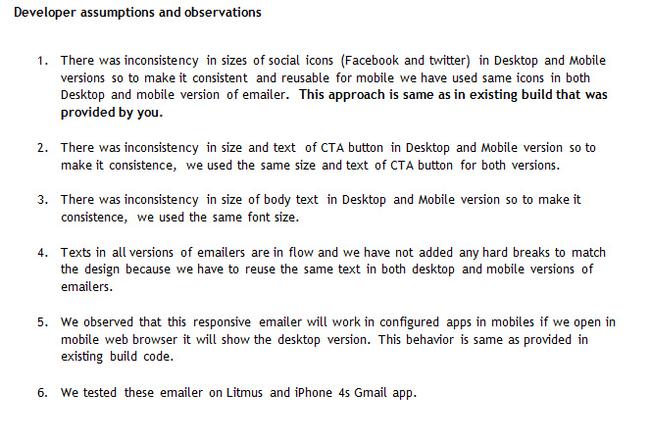
Responsive Email Assumptions Doc.
We are also maintaining a assumptions document for all responsive as well as non responsive emailer , where we write our assumptions as per email design . It is mandatory to write assumptions (if any) for all developer before sending that to QA.

Slide 40
Responsive Email View in Litmus

Slide 41
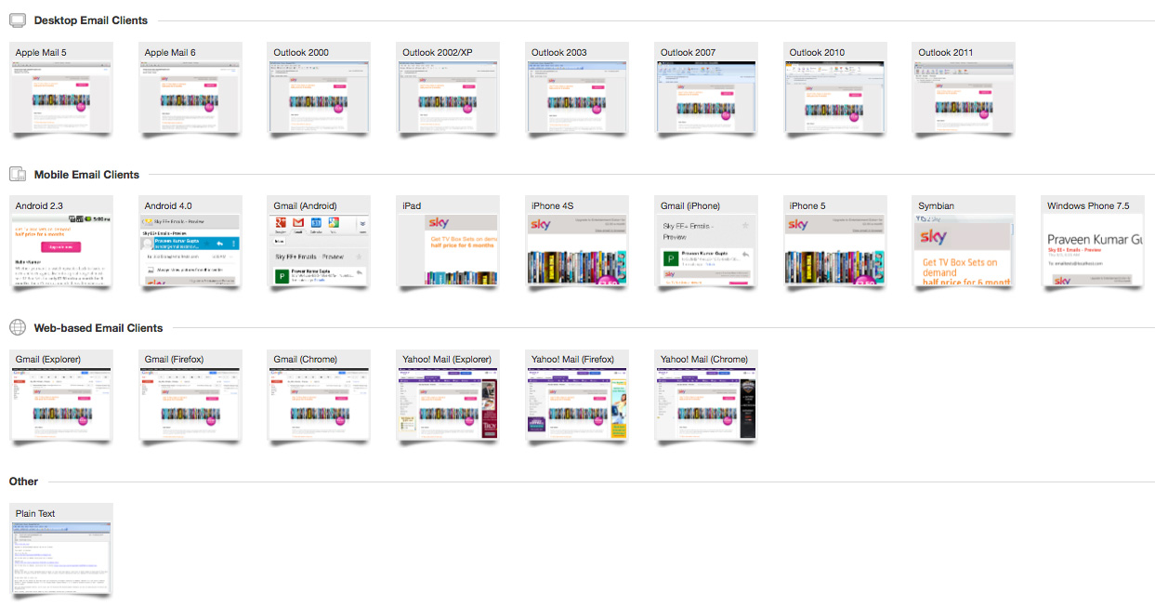
Responsive Email View in Litmus
We are using Litmus to test email.

Slide 42
Questions & Feedback

